Slide 1
CompSci 116: Lecture 13: Bias
Jeff Forbes
April 23, 2019

Slide 2
The Data Science Pipeline
Data Wrangling
Parsing, scraping, and formatting data
Data Analysis
Statistics, Prediction, etc.
Data Visualization
Selection
Preparing to run a Model
Running the model
Communicating the Resul;ts

Slide 3
Collaborating with your partners
Using a distributed version control system like Git
Use a shared directory
Go to https://jupyterhub.cs.duke.edu
Look for a directory compsci116-s19-# where # is your group number
Warning: A Jupyter notebook is not a Google Doc. Only one person should edit at a time
Now:
Go upload some data and a notebook

Slide 4
Using Data Science in Society
What’s an algorithm?
What are the advantages?
Efficient
Objective
Expanding access
What are the risks?
Data used as input
The algorithm itself

Slide 5
Challenge 1: Inputs to an Algorithm
Consider trying to generate fastest route to a destination (e.g., Google Maps). Problems include:
Poorly selected data
Incomplete, incorrect, or outdated data
Selection Bias
Unintentional perpetuation and promotion of historical biases

Slide 6
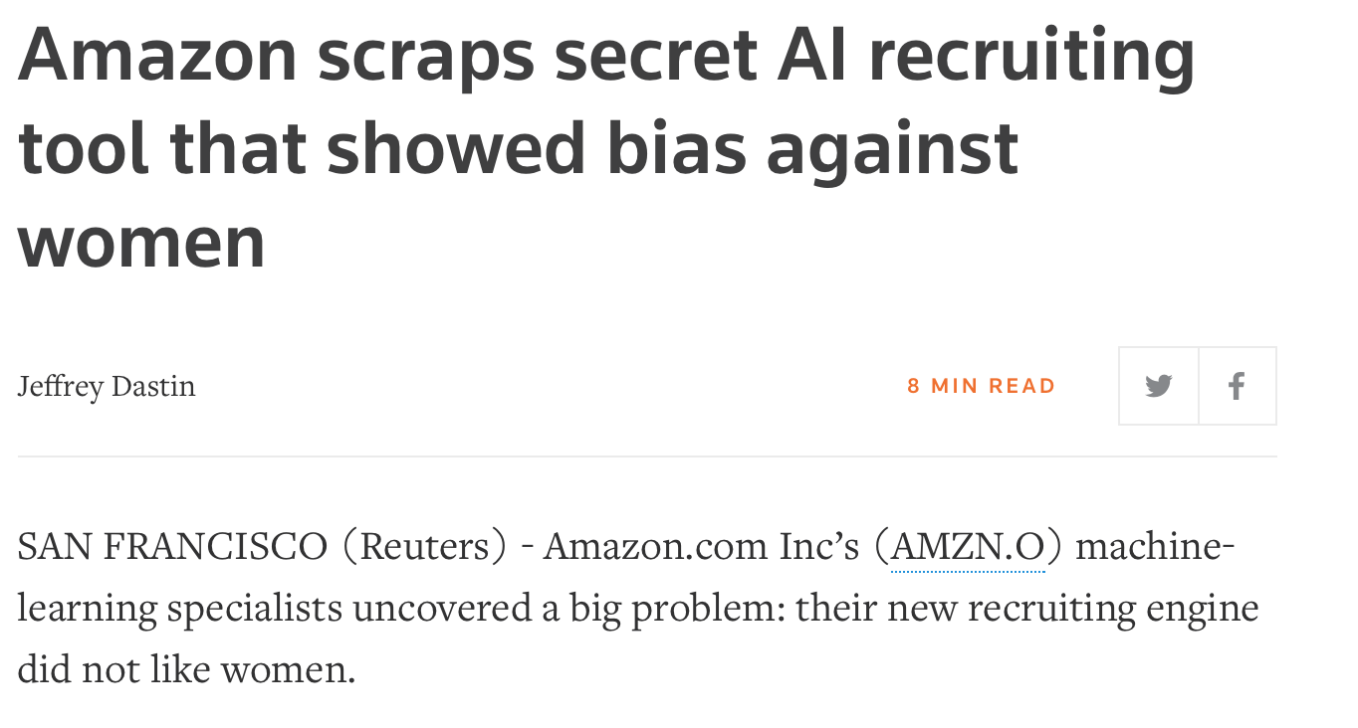
Resumé screening

Slide 7
Predictive policing

Slide 8
Challenge 2: The algorithm itself
Poorly designed matching systems
Personalization that narrow rather than expand user options
Correlation does not imply causation!
Beware of black boxes!

Slide 9
Sentencing software
Correctional Offender Management Profiling for Alternative Sanctions
Predict the likelihood of recidivism

Slide 10
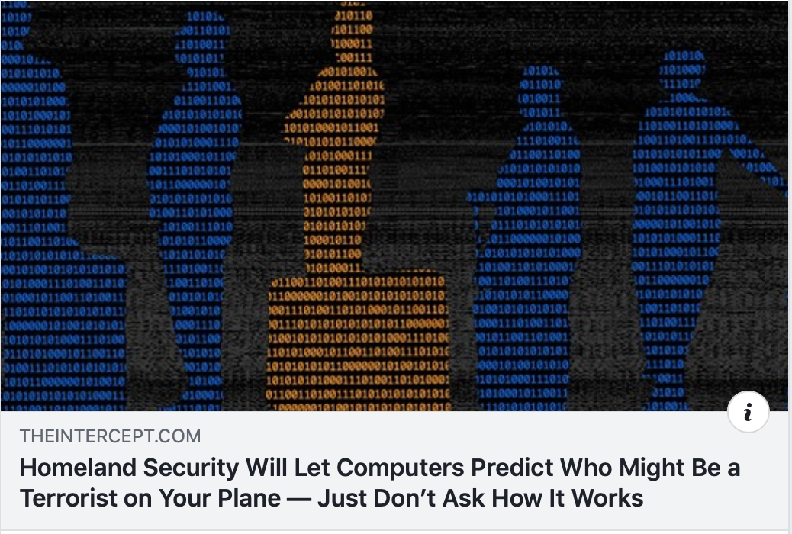
Homeland Security?

Slide 11
What’s left?
Grades
Labs 9-11 & HW 4 graded soon
Test 2 & Projects 1-3 graded by Monday, April 29
Final Project
Submit notebook, presentation, and documents via Sakai by noon, May 3
Presentations (< 10 minutes) – 2pm on May 3
Motivating questions
Methods to answer those questions
Visualizations of key results
Conclusions

Slide 12
What’s next?
CompSci 216: Everything Data
CompSci 201: Data Structures & Algorithms
CompSci 371: Elements of Machine Learning afterwards
IDM in Stats & CompSci

Slide 13
Thank you!
Please complete course evaluation on DukeHub
Complete CATME teammate evaluation
Email will go out at midnight
Complete before 5/3

